Slide 1
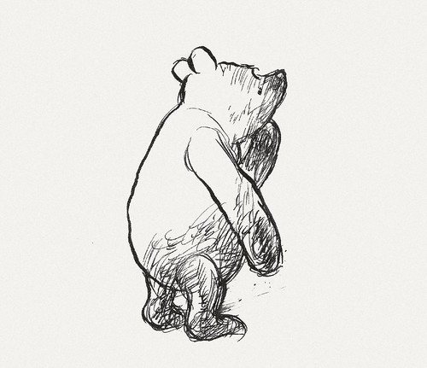
I’M BACKING ZACK POLANSKI FOR DEPUTY LEADER OF THE GREEN PARTY
If you would like us to make one for you, e-mail us at hello@zackpolanski.com
1.- INSERT YOUR PHOTO INSTEAD OF WINNIE THE POOH ! TRY TO KEEP YOUR PHOTO INSIDE THE WHITE BOX
2.- IF YOUR PHOTO IS IN FRONT OF THE LOGO/ TEXT, SELECT YOUR PHOTO AND RIGHT CLICK IT. THEN SELECT ORDER>SEND TO BACK.
5.- TRY TO PICK A HIGH RESOLUTION PHOTO
6.- SAVE AS A JPG OR PNG
8.- (DELETE THIS TEXT AFTER)
Name
local party or role (eg Cllr, Affiliated group)

